Slide 1
Mapping Ratty:
The National Water Vole Database & Mapping Project
Restoring Ratty Conference
11th – 12th October 2018
Catherine McGuire
Notes:
Introductory – who I am, what presentation is about
Show of hands – how many saw 30% decline news?
Show of hands – how many have heard of the project?
No animation

Slide 2
National Water Vole Mapping and Database Project
Proposed by UK Water Vole Steering Group in 2008
Responded to revised BAP targets to maintain and increase water vole range from 730 10km grid squares to 835 by 2015
Two primary aims
To assess national status and trends of water vole and American mink distribution
To use GIS to enable strategic water vole conservation at local, regional and national levels
Notes:
Background to project – as per slide
No animation
Image of UK BAP logo

Slide 3
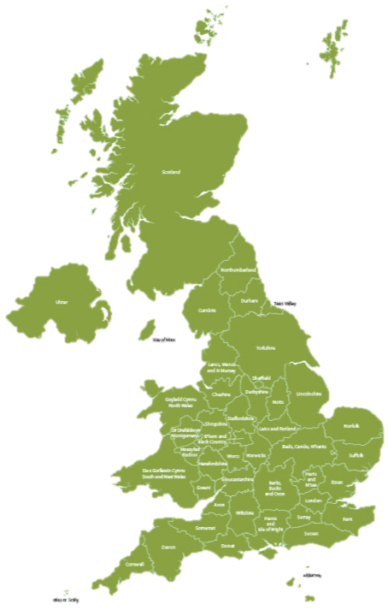
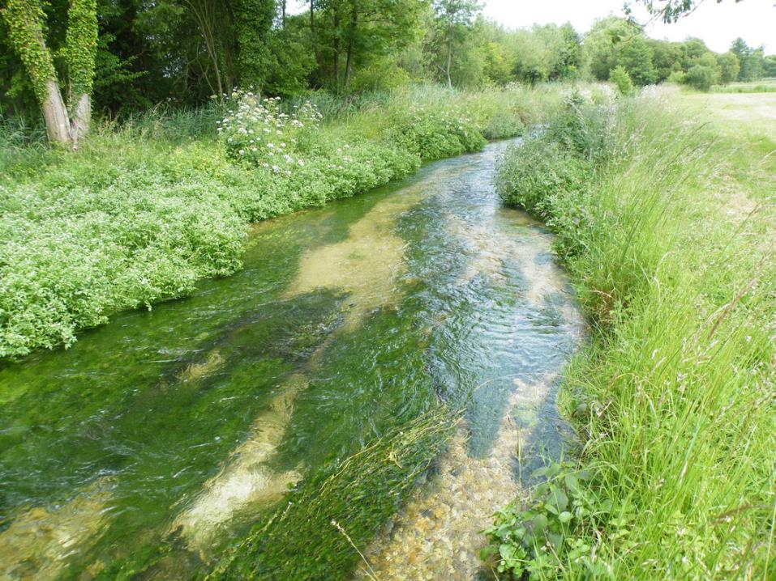
About us
Project Manager: Ellie Lewis, TWT Central Team
Project Officer: Catherine McGuire, HIWWT
The Wildlife Trusts are:
Grassroots movement
46 individual Wildlife Trusts
Come together as The Wildlife Trusts
800,000 members
40,000 volunteers
2,300 nature reserves covering 98,500 ha
We are uniquely placed to deliver this national project
TWT
HIWWT
Notes:
Background to why WT manage and deliver this project
ANIMATION
Wildlife Trusts are…fades in on click
6 x bullet points fade in after previous
Final statement appear on click then pulse after previous
Background image of river with foreground image map of Trusts with stars and labels for TWT and HIWWT

Slide 4
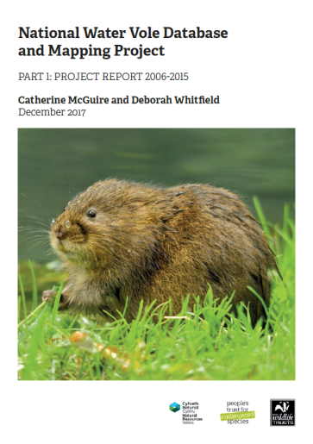
Annual Project Steps:
Collate all the records
Clean the data
Map records as points
Apply modelling approach
Produce suite of maps including “key area” maps
Publish annual report and disseminate
Notes:
Preamble to following slides.
Overview of main project steps from gathering records to disseminating outputs
No animation
1 x image of front cover of latest report

Slide 5
The database
113,000 records
90+ data suppliers
23,000 mink records
90,000 water vole records
Notes:
About the database
Smart art graphic showing central theme of total number of records, with number of data suppliers and number of water vole and mink records
No animation
1 x image of woman with exploding computer screen

Slide 6
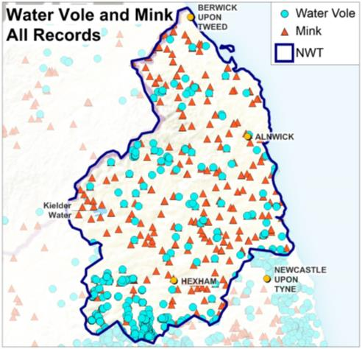
GIS analysis – records
MISSING DATA!
How can we improve submission of records?
Notes:
Explain GIS analysis – records.
1 x image – map of NWT area with WV and mink records
Pose “Missing Data” question to audience - to be discussed in workshop.
ANIMATION
Circle appears around Kielder on click
Missing data statement appears and expands on click
Question – how improve – appears and expands with previous
Clipart thinking person graphic – appears and expands with previous

Slide 7
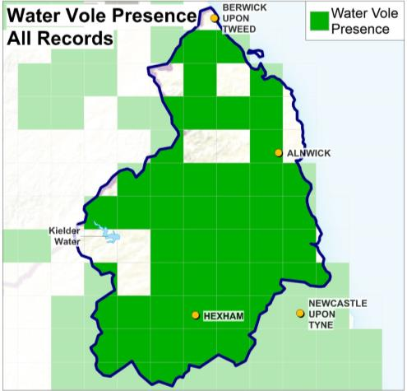
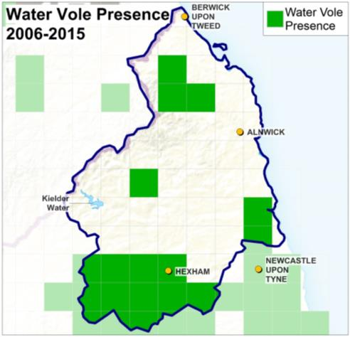
GIS analysis – distribution
Notes:
Explanation of GIS analysis step 2 – distribution
2 x images – map 1 showing distribution map for WV in NWT area for all records, map 2 showing same but for 2006-2015 records
ANIMATION
Map 1 appears on click
Map 2 fades in on click

Slide 8
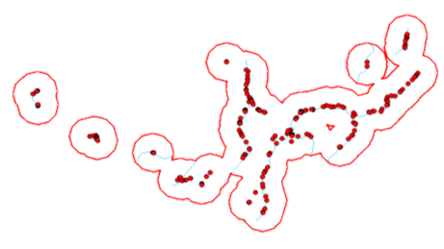
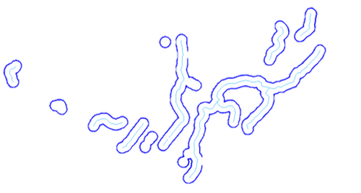
GIS Analysis – Creation of Alert Areas
Methodology based on work developed by Beds, Bucks and Oxon Wildlife Trust (BBOWT)
Summarised in 3rd Ed. Water Vole Conservation Handbook (Strachan and Moorhouse 2006)
Series of buffers around records and rivers
2km potential dispersal zone = alert area
RECORDS ALERT AREA
Notes:
Explanation of GIS analysis step 3 – creation of alert areas
No animation
2 x images: extracts of alert area mapping showing first and last steps with text box explaining records to alert area and connecting arrow

Slide 9
National Reporting
Recap of project aims:
To assess national status and trends of water vole distribution
To use GIS to enable strategic water vole conservation at local, regional and national levels
© Tom Marshall
Notes:
Recap of project aims
No animation
1 x image of water vole

Slide 10
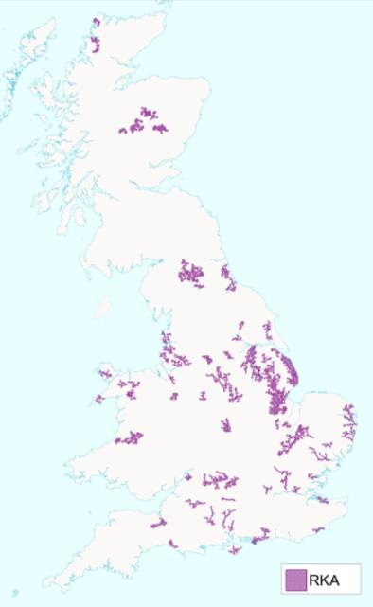
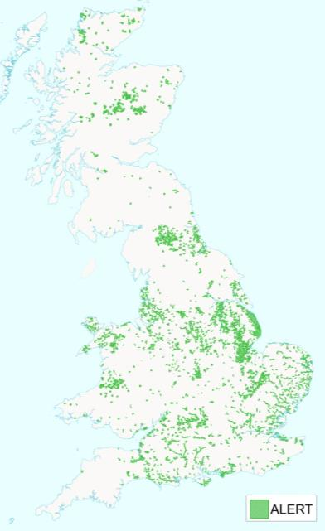
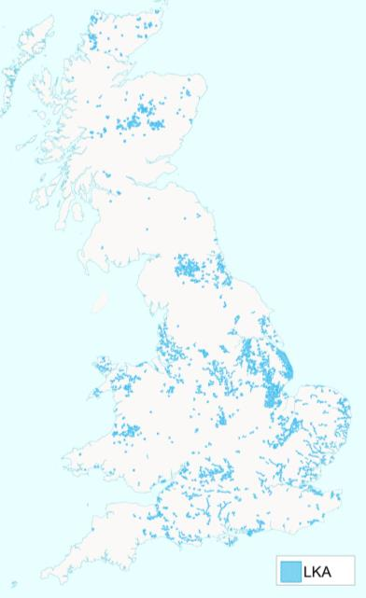
Aim 2: Mapping Key Areas
Alert Areas:
2km buffered water vole records
Local Key Areas:
6km² or greater
Important for local populations of water voles
Regional Key Areas:
35km² or greater
More likely to survive stochastic events and persist for 40+ years
Notes:
Explaining aim 2 – alert, local and regional key areas
ANIMATION
Alert areas map title plus 1 bullet point plus UK map of Alert areas fade in on click
Local Key Areas title plus 2 bullet points plus UK map of LKAs fade in on click
Regional Key Areas title plus 2 bullet points plus UK map of RKAs fade in on click

Slide 11
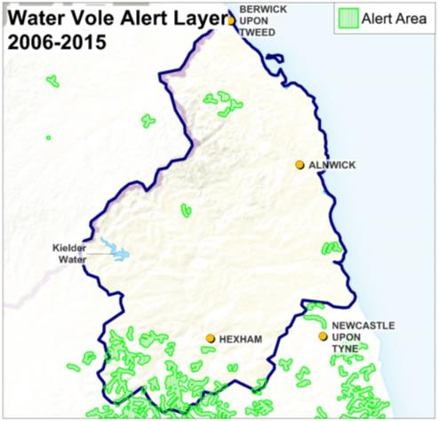
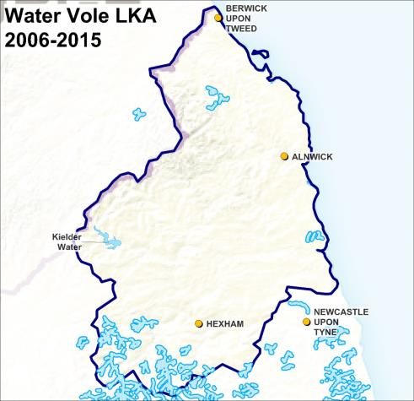
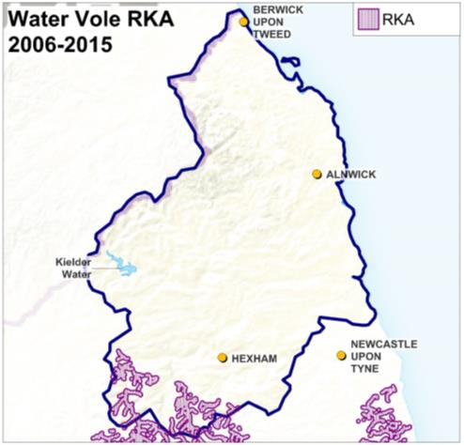
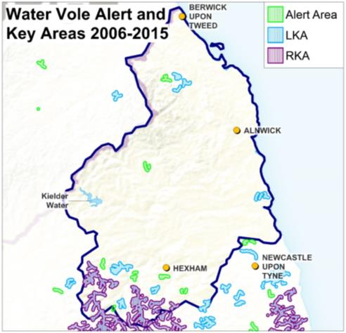
Alert, Local & Regional Key Area Mapping
Notes:
Explanation of alert, local and regional key areas mapping using NWT example
Images: see animation details
ANIMATION
Map 1: alert areas – appears on click then fades on click
Map 2: local keys areas – appears on previous then fades on click
Map 3: regional key areas – appears on previous then fades on click
Map 4: combined map of 1-3 – appears on previous
Yellow oval west of Hexham – fades in on click then fades out on next click
Yellow over between two RKAs fades in on previous

Slide 12
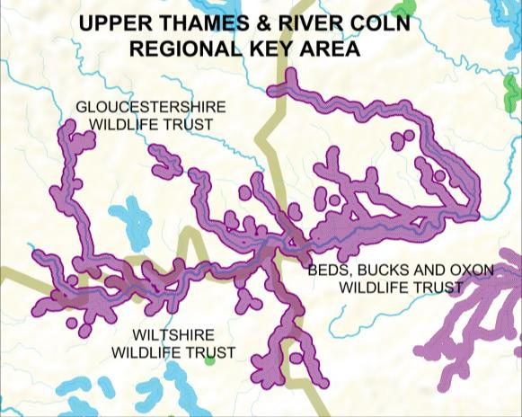
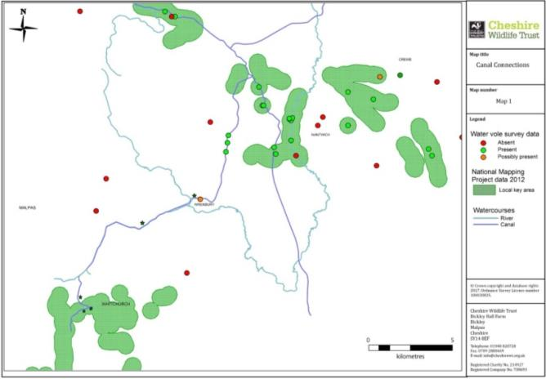
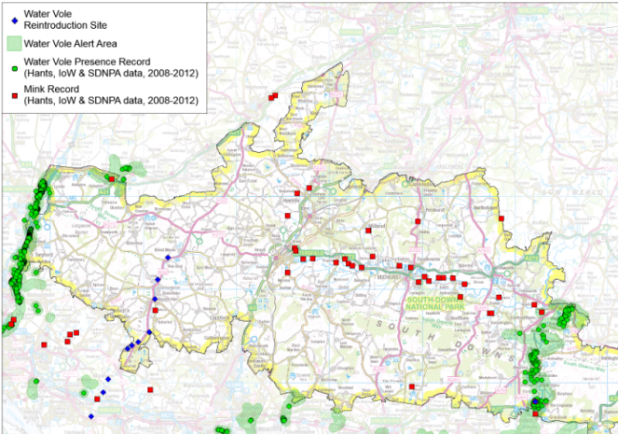
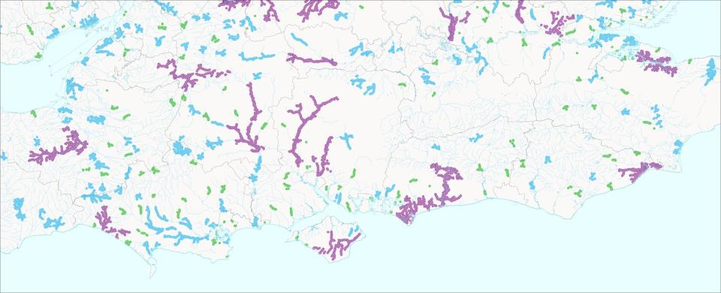
The maps in action
Notes:
Three examples of how the alert maps are used.
Quick show of hands – how many use the maps or can see potential for using them? Request for feedback.
4 x images:
Background map of south central England
3 x maps for BBOWT, SDNPA and CWT projects – see animation details
ANIMATION
Background Map – fade out on click and Map 1 (BBOWT Upper Thames and River Coln Regional Key Area map) – fade in on previous
Map 2 (SDNPA map) – fade in on click
Map 3 (Cheshire Wildlife Trust map) – fade in on click

Slide 13
Aim 1: Assessing the trends
Amazing work has been done and continues to be done.
We should be proud.
But… have we done enough?
© Darin Smith
Notes:
Moving on to Aim 1 – have we done enough?
No animation
1 x image of water vole (Darin Smith)

Slide 14
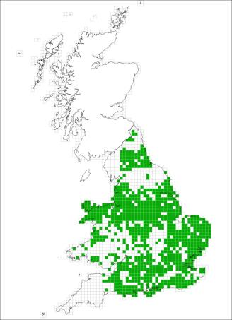
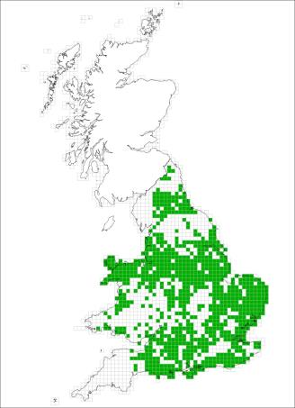
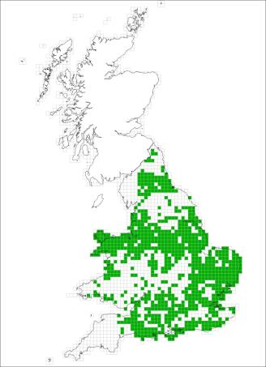
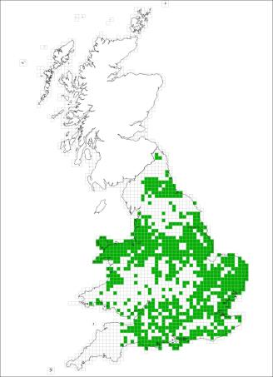
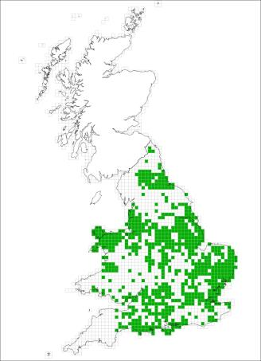
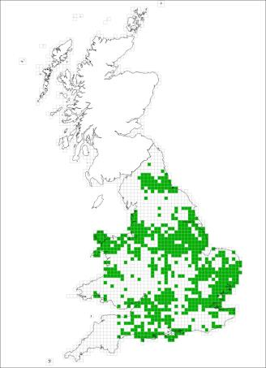
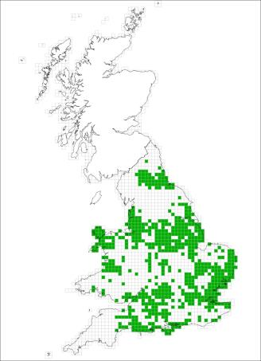
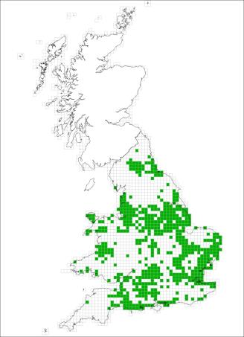
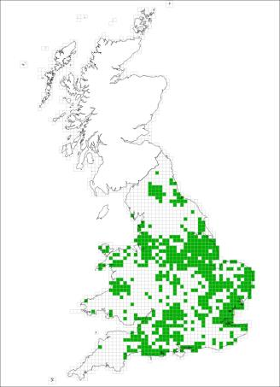
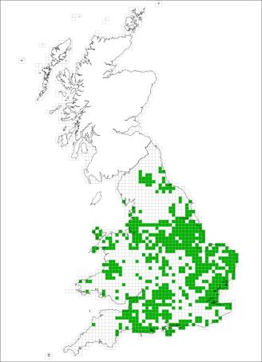
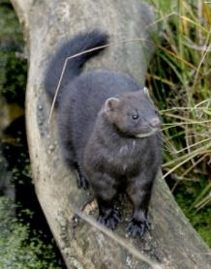
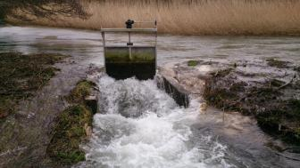
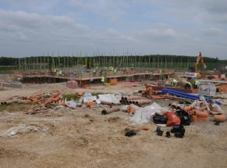
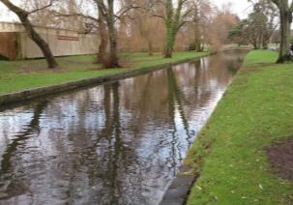
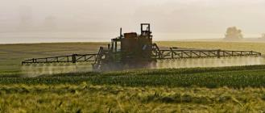
The national picture – have we failed the BAP targets?
2002-2006
2003-2007
2004-2008
2005-2009
2006-2010
2007-2011
2008-2012
2009-2013
2010-2014
2011-2015
Sadly – yes.
Notes:
Critical assessment of results against targets
Static photos x 5 – mink, development site, river flooding, hard engineered river, crop spraying
Images x 10 – see animation details
ANIMATION
Map 1: 2002-2006 – wipe up on click
Map 2: 2003-2007 – wipe up on click, overlay previous
Map 3: 2004-2008 – wipe up on click, overlay previous
Map 4: 2005-2009 – wipe up on click, overlay previous
Map 5: 2006-2010 – wipe up on click, overlay previous
Map 6: 2007-2011 – wipe up on click, overlay previous
Map 7: 2008-2012 – wipe up on click, overlay previous
Map 8: 2009-2013 – wipe up on click, overlay previous
Map 9: 2010-2014 – wipe up on click, overlay previous
Map 10: 2011-2015 – wipe up on click, overlay previous

Slide 15
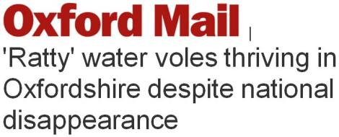
It’s not all bad news…
Notes:
Positive local news stories despite grim figures
Images x 3 – see animation details
ANIMATION
Image 1: ITV News screenshot for Cambs – zoom appears on click
Image 2: Oxford Mail screenshot for Oxon – zoom appears on click
Image 3: Telegraph screenshot for fightback but still need help… – zoom appears on click

Slide 16
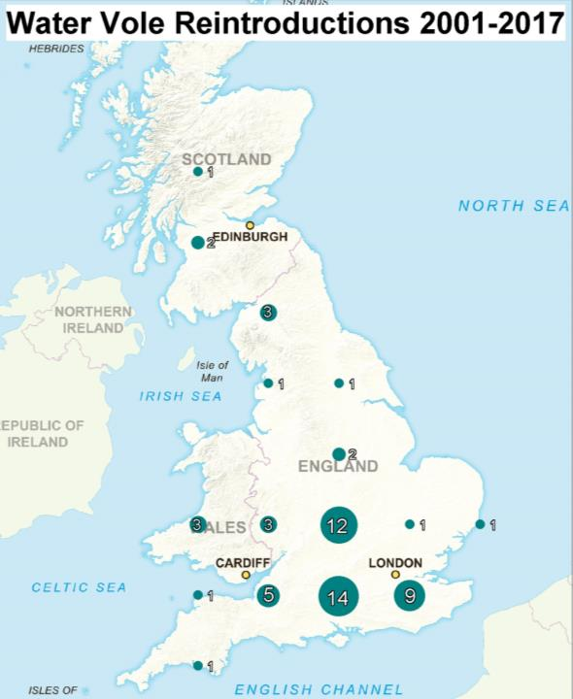
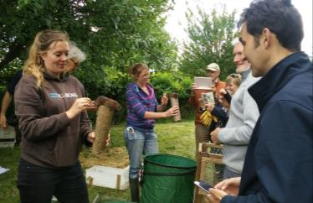
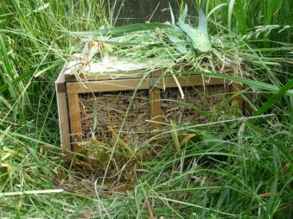
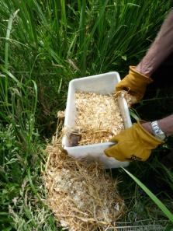
Fighting back:
reintroductions
Notes:
Quick representation of areas where water vole reintroduction work taking place, grouped by 100km grid square
No animation
4 x images:
Broad map of water vole reintros by 100km square
2-3. 3 x photos from various reintros

Slide 17
So, what next…?
Notes:
Introduction to final slides and recommendations
No animation

Slide 18
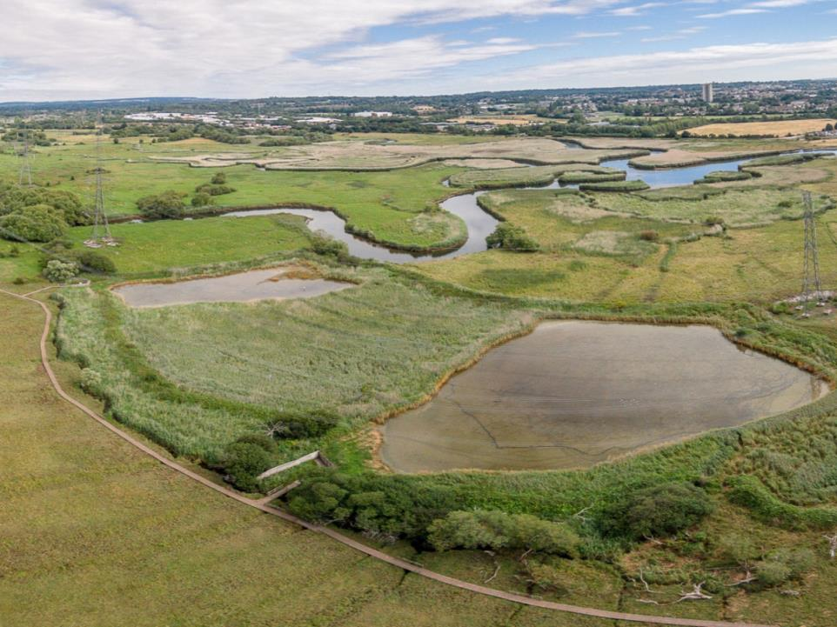
Recommendations: Government
Revise the UK strategy for water vole conservation
Support landscape-scale water vole conservation programmes
© Martin Ellis
Notes:
Recommendations for government
No animation
1 x image: background full slide image Lower Test Marshes

Slide 19
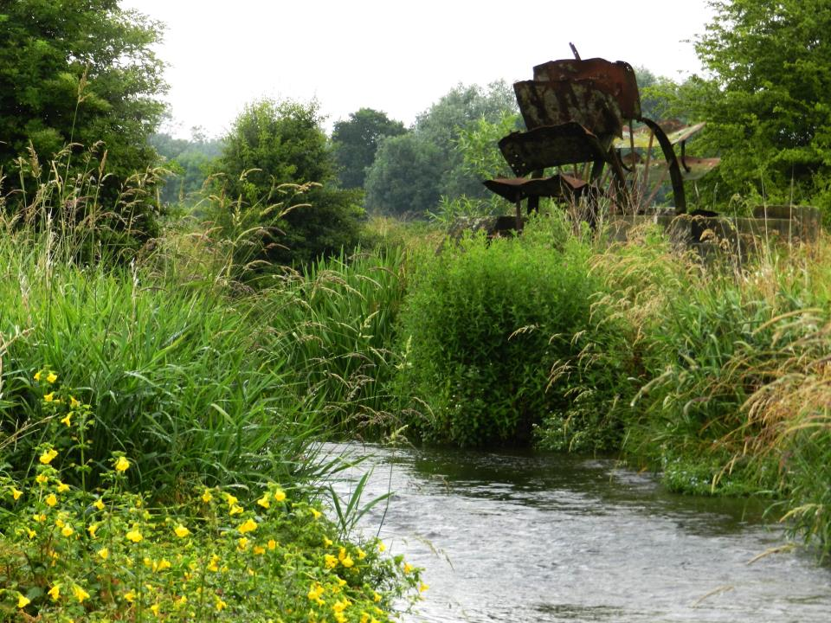
Recommendations: Landowners
Manage riverbank habitat positively
© HIWWT
Notes:
Recommendations for landowners
No animation
1 x image: full slide background image of St Clair’s Meadows

Slide 20
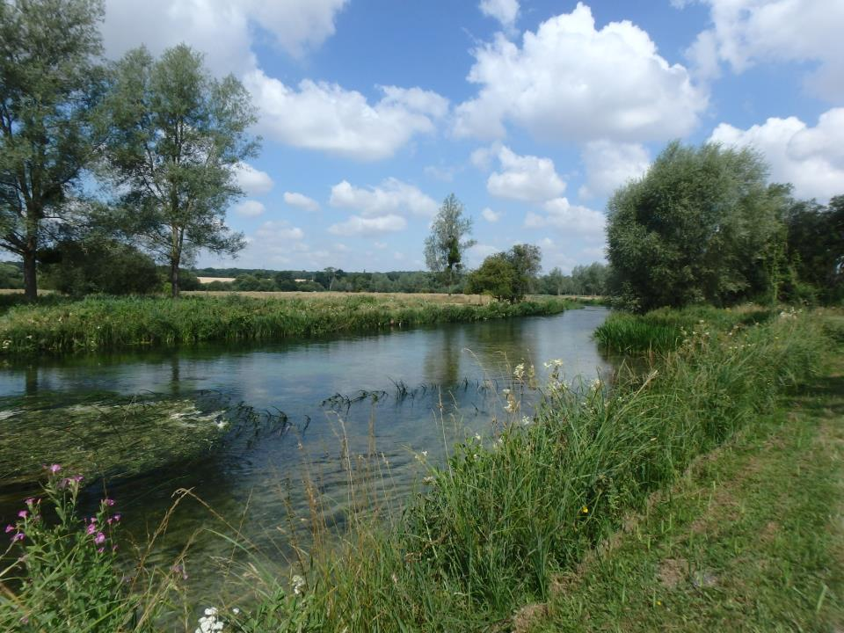
Recommendations: Conservation Charities
Enlarge and expand conservation projects
Continue to monitor water vole populations
Invest further in volunteers
Use alert maps
Document and disseminate
© Sarah Jackson
Notes:
Recommendations for conservation charities
No animation
1 x image: full slide background image of private estate

Slide 21
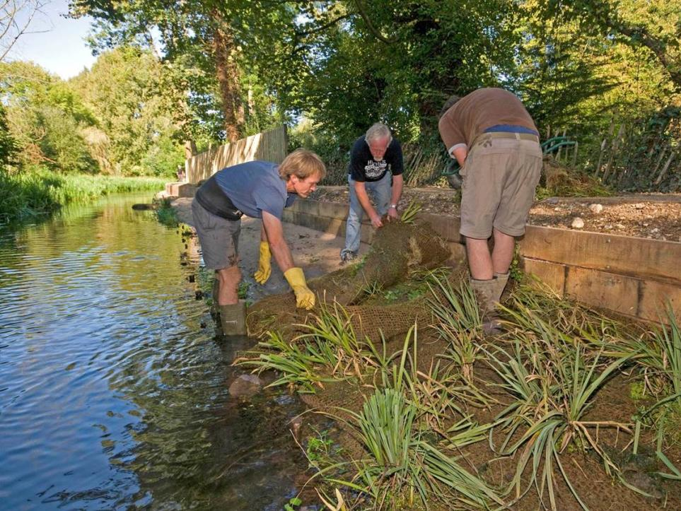
Recommendations: Individuals
Volunteer
Donate
© HIWWT
Notes:
Recommendations for individuals
No animation
1 x image: full slide background image of River Itchen volunteers

Slide 22
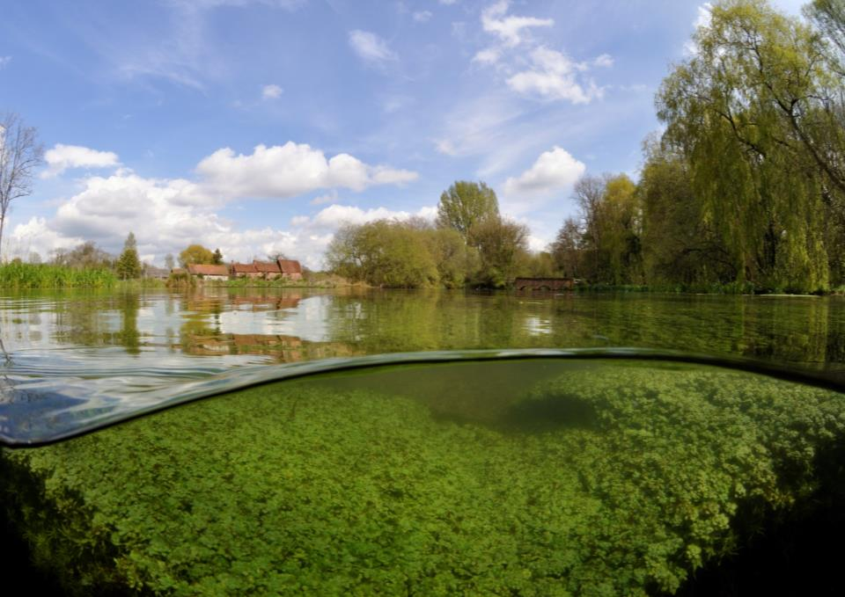
What you can do
Send your records to your LERC
Send us your feedback and case studies
Please consider funding us!
© Linda Pitkin
Notes:
What attendees can do today!
No animation
1 x image: full slide background image of Itchen Stoke

Slide 23
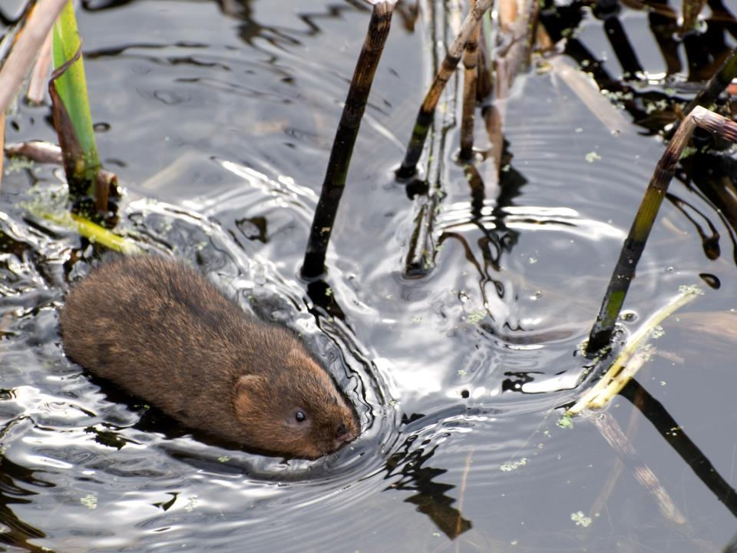
Thank you!
© Dave Foker
Notes:
Closing slide – thanks to all who have contributed to the project
No animation
1 x image: full slide background image of water vole

