Slide 1
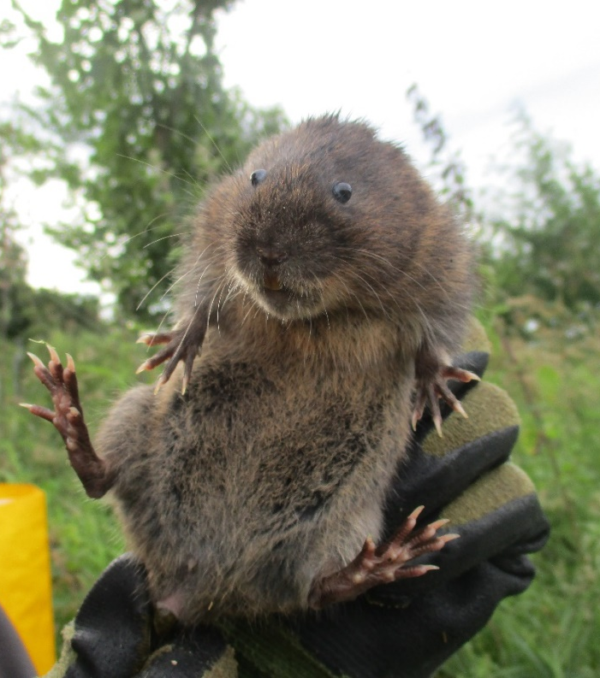
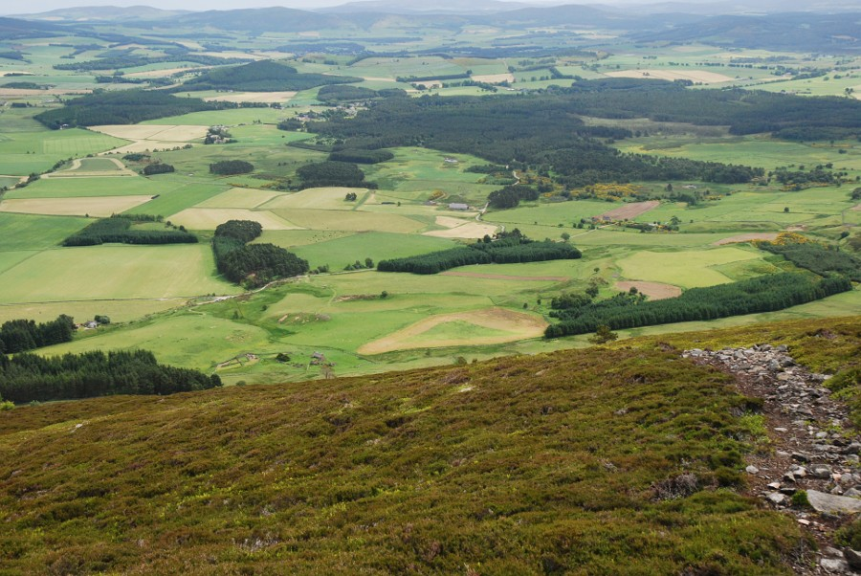
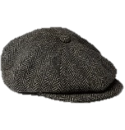
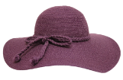
Looking towards spatial recovery of water voles:
Lessons from natural and assisted recolonisation
William Morgan
Xavier Lambin
william.morgan@abd.ac.uk @W_Morgan_

Slide 2
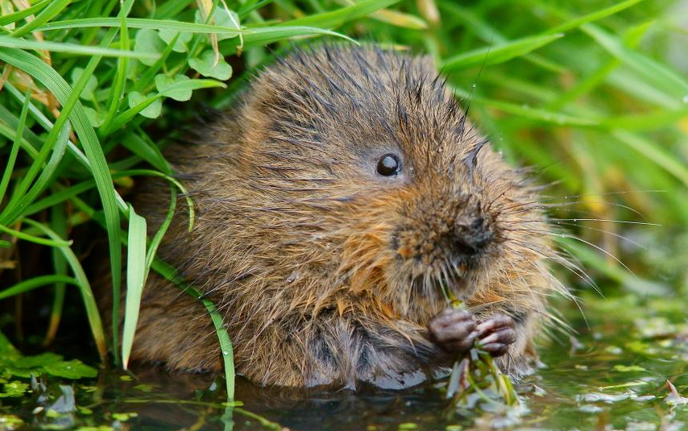
Start with a “simple” question:
?
How do populations spread in to empty, suitable landscapes?
Notes:
How do populations go from “this” to “this”
What population processes underlie these changes to species distributions?
Can understanding those processes help to inform conservation management?

Slide 3
Changes from “core” to “edge”
Core:
Continuous occupancy
Edge:
Patchy occupancy
Beyond edge:
Empty
Notes:
Lets consider how species distributions change throughout their range
Core → edge → beyond edge

Slide 4
Colonisation of new patches:
Expansion

Slide 5
Colonisation of new patches:
Expansion

Slide 6
Local extinction events:
Contraction
Species distributions “emerge” from colonisation and local extinction events

Slide 7
A slightly more complicated question:
?
?
How long will it take?
?

Slide 8
Scale of colonisation effects rate of expansion

Slide 9
Scale of colonisation effects rate of expansion
Small scale
=
Slow expansion

Slide 10
Scale of colonisation effects rate of expansion

Slide 11
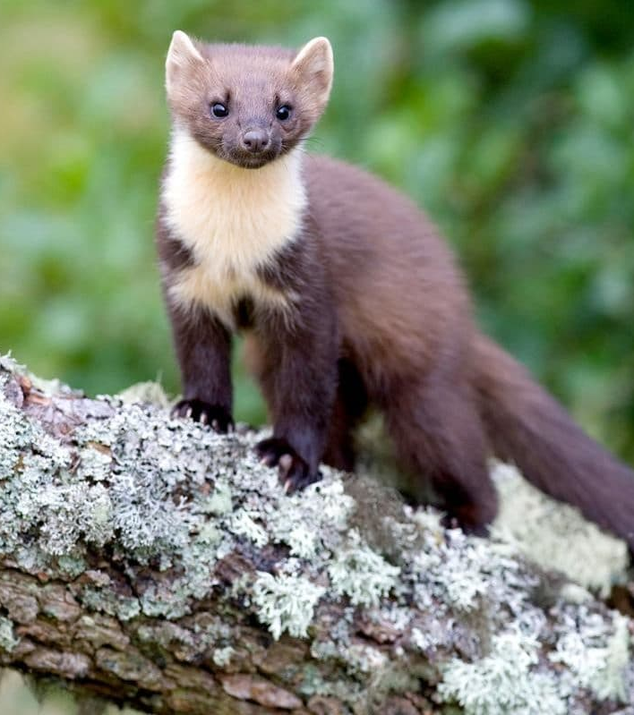
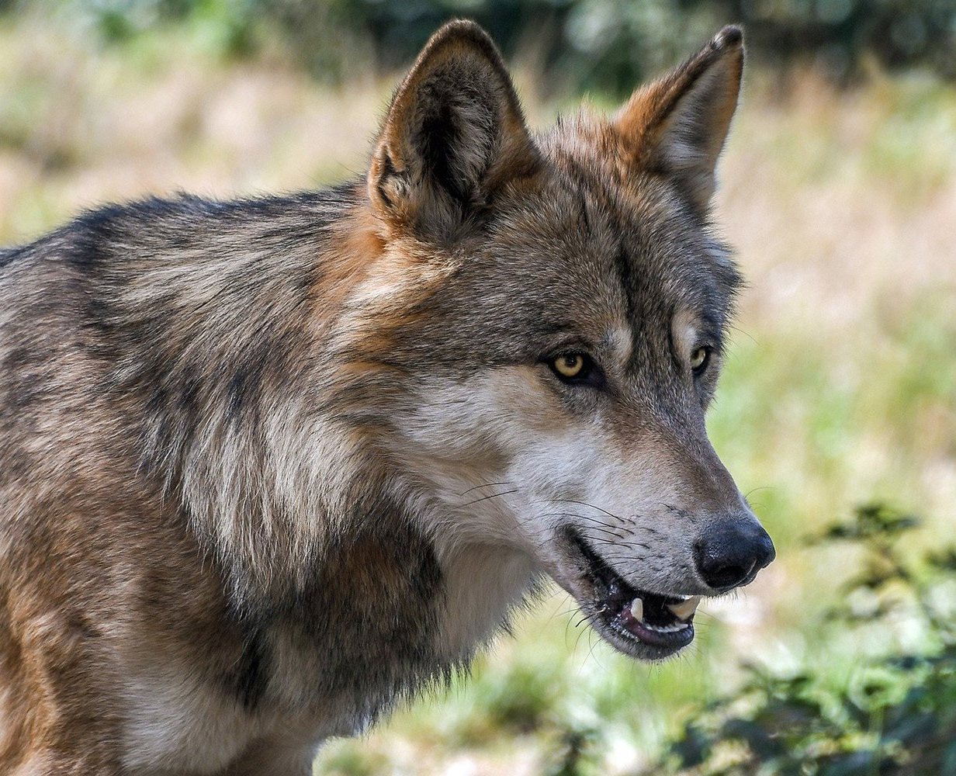
Scale of colonisation effects rate of expansion
Large scale
=
Rapid expansion
Increasing spatial scale of colonisation

Slide 12
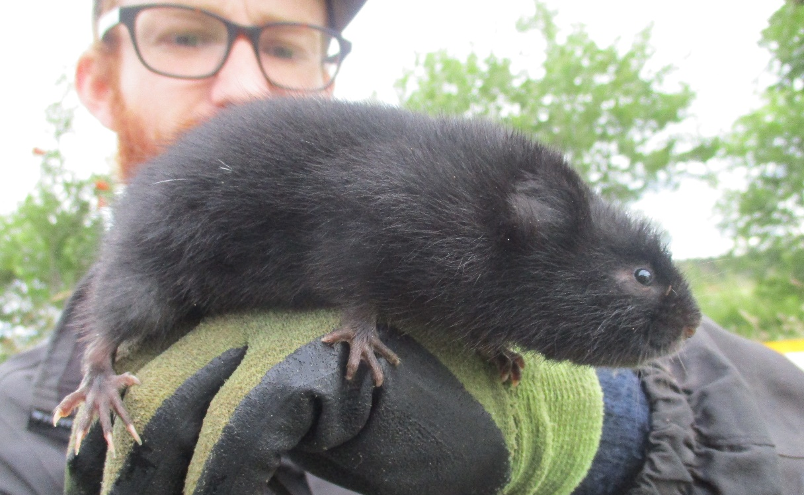
Why is this relevant for Water voles?
A NE Scotland case study
Notes:
Case study of water vole metapopulation in Assynt
Number of adults is key for subpopulation persistence
Number of juveniles in neighbouring patches is key for colonisation
So what about patches beyond the current range?
Case study of recovering water vole metapopulation
Connectivity low at edge of range
Newly colonised patches small with high probability of extinction
Limiting factor for range expansion

Slide 13
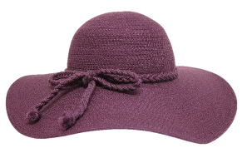
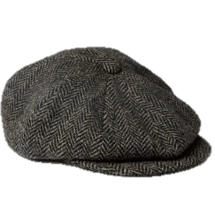
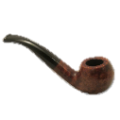
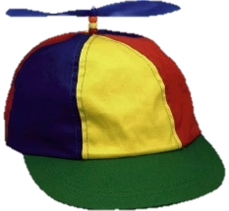
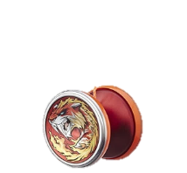
Why is this relevant for Water voles?
Adults stay at home
A NE Scotland case study
Juveniles colonise neighbouring patches

Slide 14
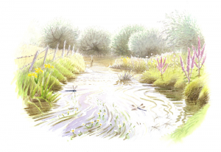
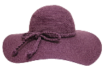
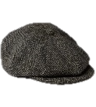
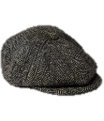
The drivers of colonisation and local extinction
Colonisation: dispersing juveniles
Extinction: Pop size + RESCUE EFFECT
John Davis – Manwood Wildlife Heritage group
Suffolk Wildlife Trust

Slide 15
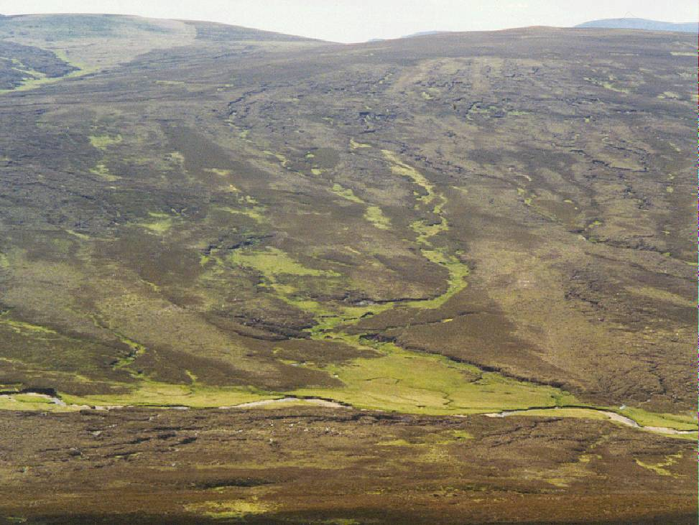
Water voles are great dispersers!
2.8 km
1 km
2.2 km
Recolonisation should be rapid…
2.5 km
… yet recovery has been slow
Moved 7.5 km over 4 weeks!

Slide 16
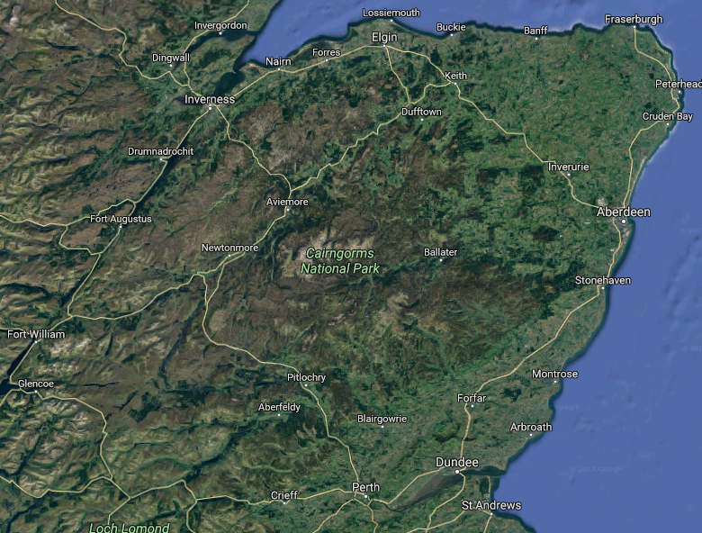
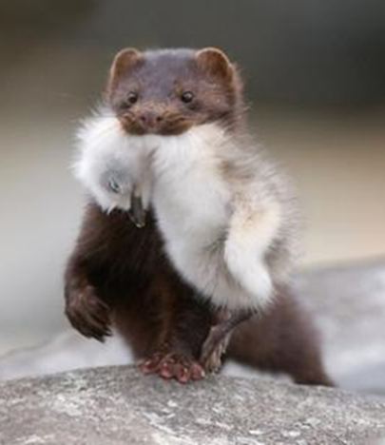
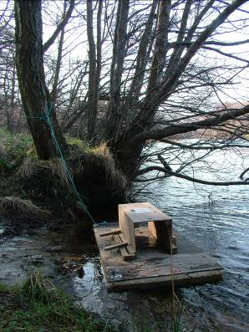
Large scale, coordinated control of American mink
Notes:
16

Slide 17
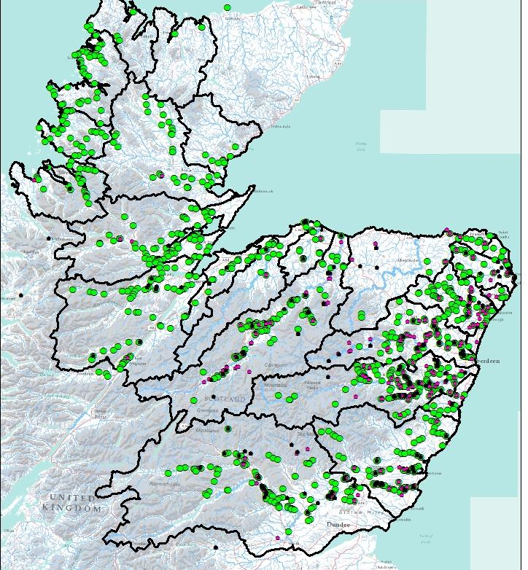
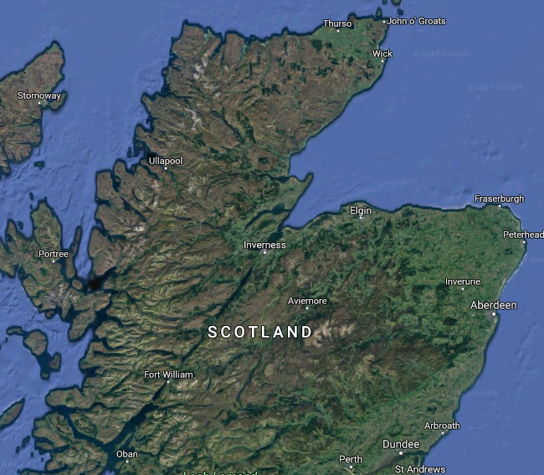
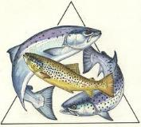
Partnership and volunteers removed breeding mink from over a 29,000 km² area bounded by seas and mountains

Slide 18
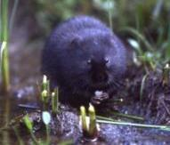
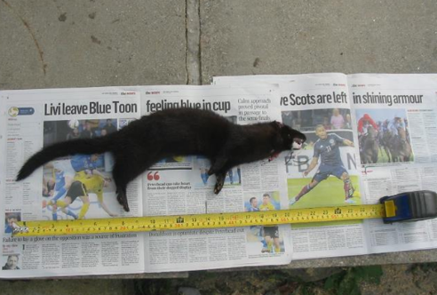
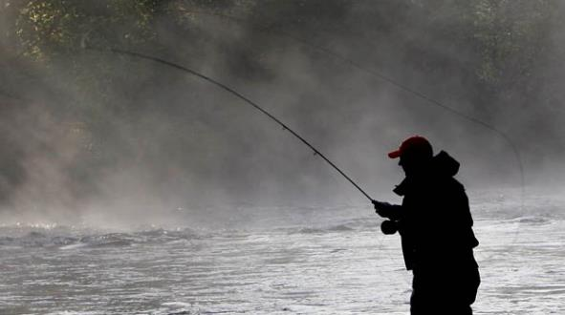
Embedding with users of salmon resources to ensure legacy for as long as wild salmons run up Scottish rivers
Rolling out and spatial targeting of mink control to “attractive sinks”
Transfer of management responsibility to river trusts to ensure mink control and monitoring is self-sustained with limited (but not zero!) input of additional resources.

Slide 19
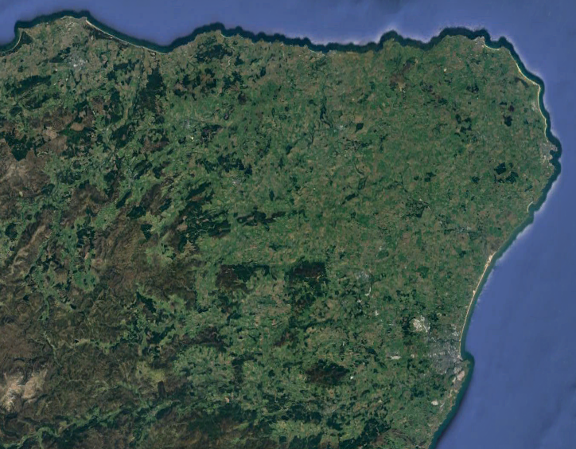
A remnant (and recovering?) water vole population:

Slide 20
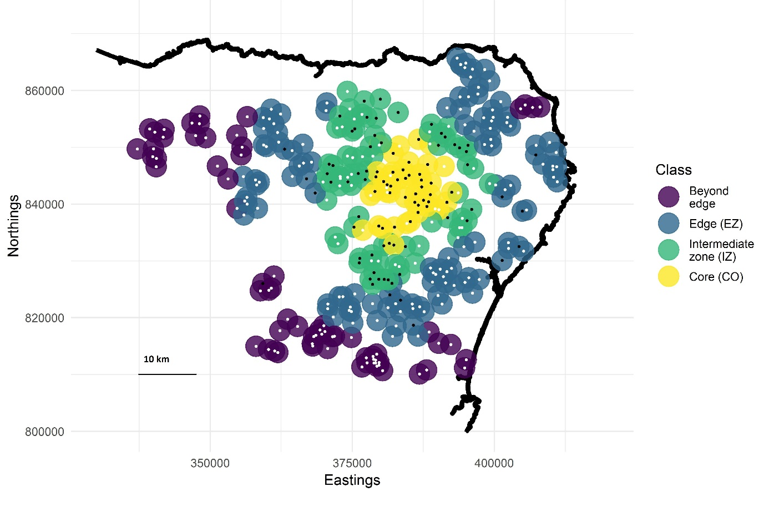
“Steep” population edge – NOT due to habitat quality

Slide 21
KEY QUESTION:
What processes might limit the rate of spatial spread?
“Steep” population edge:
→ Typical when immigration key for local persistence
Lower chance of colonisation
Higher chance of extinction
Density
Beyond edge
Core

Slide 22
KEY QUESTION:
What processes might limit the rate of spatial spread?
Species translocations offer a unique opportunity to learn more!
!
!
(…with benefits to conservation of course!)
!

Slide 23
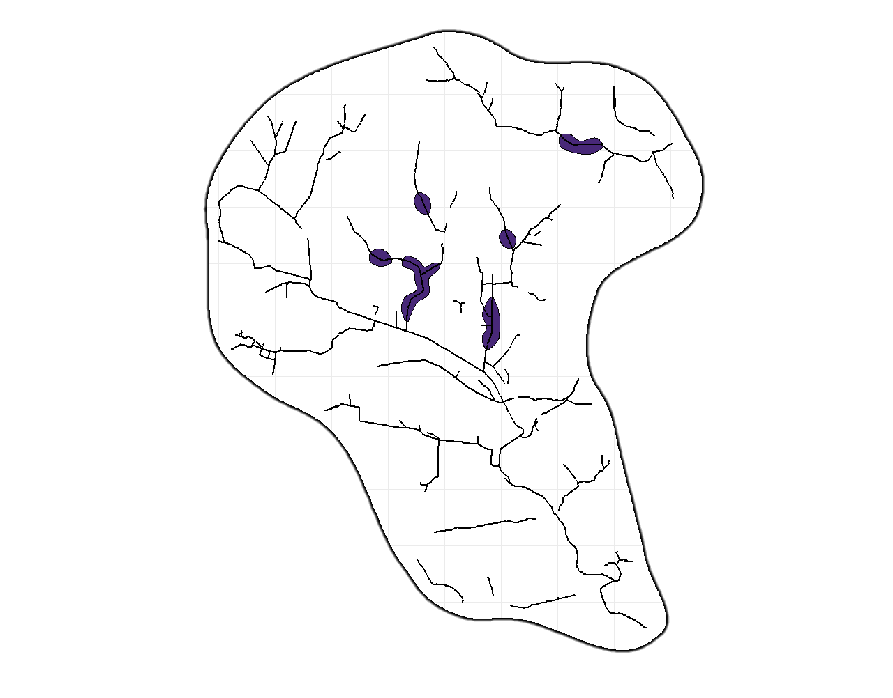
Reintroduction experiment :
Release locations =
Waterway=
3 km

Slide 24
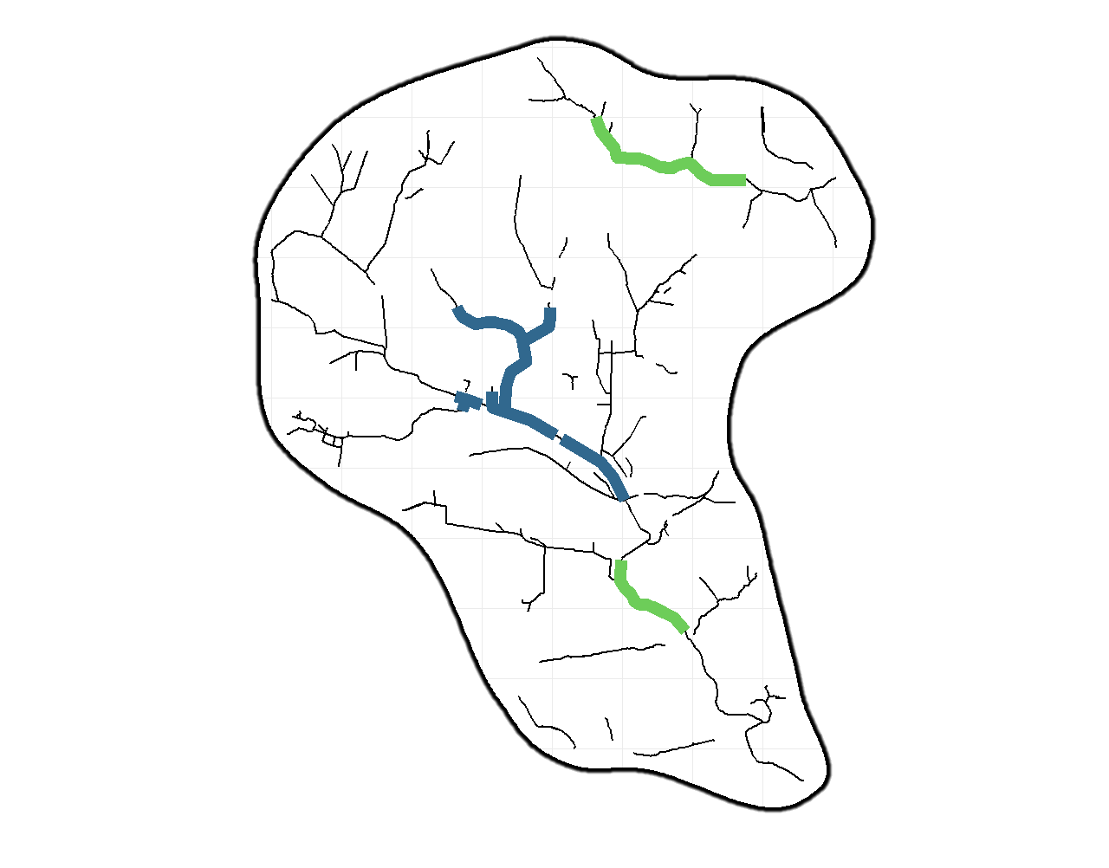
Reintroduction experiment :
Population established
Most of catchment never colonised
A persistent core emerged
Some long distance colonisation - transient
Persistent core
Transient periphery
3 km
Notes:
Very happy to report that the reintroduction has been a success – despite floods and even a mink!

Slide 25
1. Small scale of colonisation compared to known water vole dispersal ability…
Our reintroduction: Maximum of ~ 1.7 km
More established populations: Mean of 1.8 km
2. Presence of voles in surrounding waterway more important than habitat quality…
Though habitat key for persistence

Slide 26
No breeding occurred outside the box
Clustering around “breeding centres”
3 km

Slide 27
Voles are attracted to other voles…
John Davis – Manwood Wildlife Heritage group
Suffolk Wildlife Trust
… So suitable, empty habitat remains empty

Slide 28
It’s hard to find a mate in an empty world…
Translocations can help solve the problem!

Slide 29
1. Create more targets for dispersers

Slide 30
2. Increase the number of dispersers

Slide 31
1. Create more targets for dispersers
REINTRODUCE BEYOND EDGE
High risk, high (potential) reward
“Easy” to measure success
2. Increase the number of dispersers
?
?
REINFORCE BEHIND EDGE
?
Lower risk, lower rewards
Hard to quantify success

Slide 32
But Not all voles behave the same…
A simple in-hand measure of “docility”
Multiple measures per individual
Individuals show consistent response over time

Slide 33
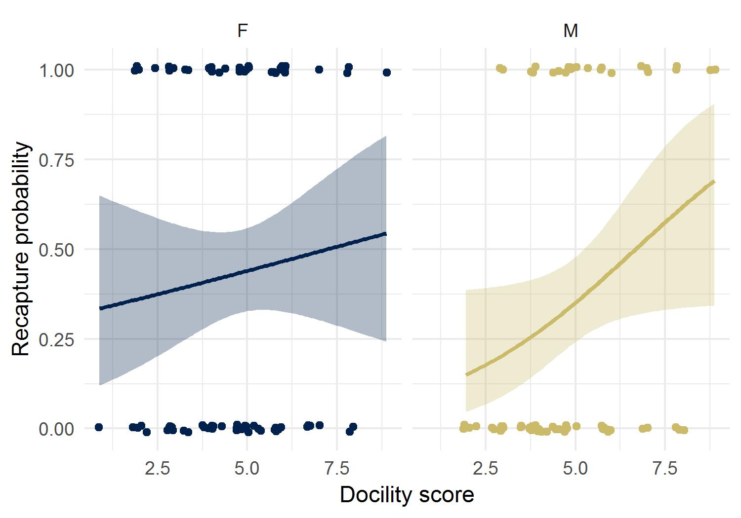
Behaviour measure predicted survival in release site…

Slide 34
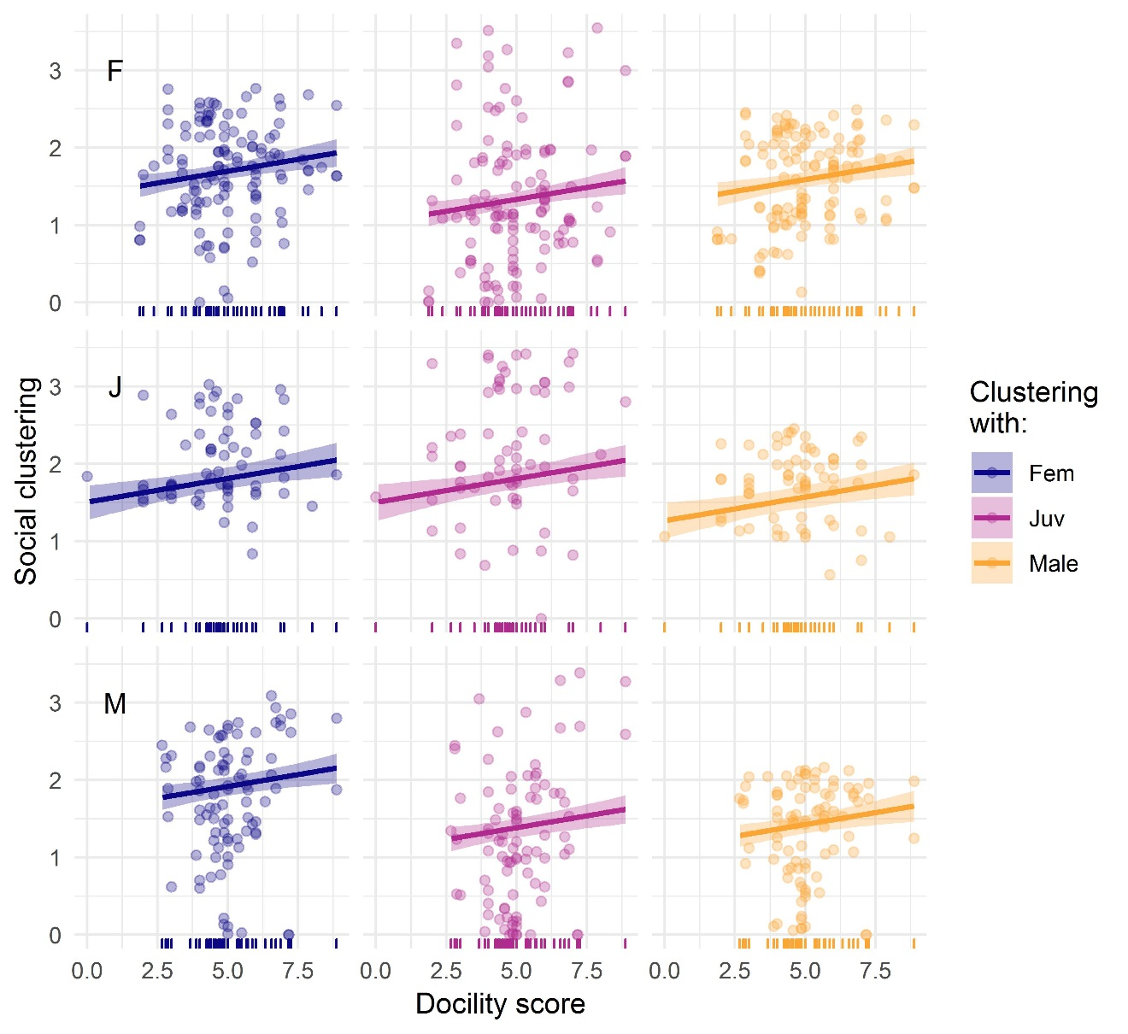
… and predicted degree of clustering!

Slide 35
Consequences for reintroduction planning?
Some voles more suited to reintroduction that others?
Some voles suited to certain kinds of reintroduction?
High between individual variation may lead to greatest success
?
?
?
?
?
?
?
?
?
?
?
?
?

Slide 36
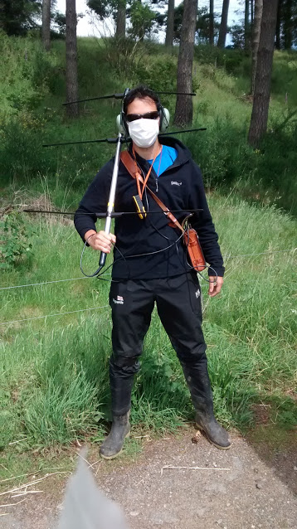
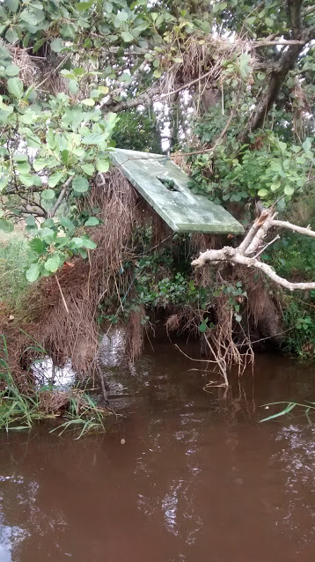
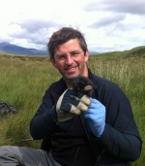
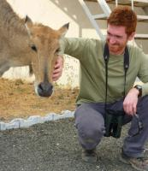
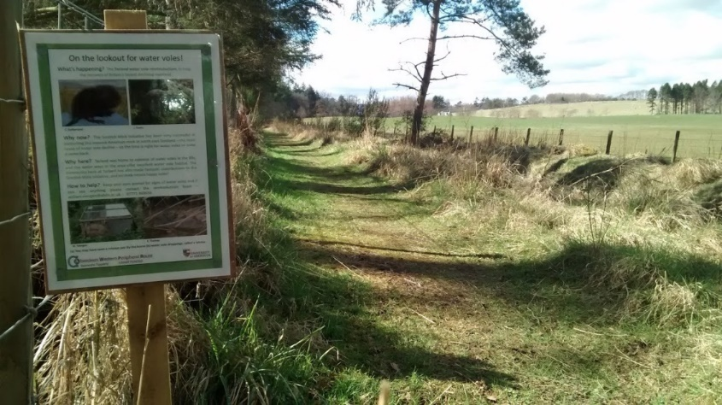
Thank you to…
Xavier Lambin
Thomas Cornulier
Julio Dominguez
Deon Roos
Ewan McHenry
Emma Bryce
Emma Sheehy
Rupert Houghton
And all the farmers on the estate!

